Slide 1

Database Project
Project Title: www.socialz.com
Submitted To:
Name: Md. Shohel Bashar
Lecturer,
Department of Computer science and Engineering
State University of Bangladesh
Submitted By: Group 2
Name: Rubaiyat Sha Fardin Siam
ID No: UG02-56-21-001
Batch: 56
Session: Spring 2023
Name: Riadul Islam Sakib
ID No: UG02-56-21-008
Batch: 56
Session: Spring 2023
Name: Md. Rabbi hasan
ID No: UG02-56-21-005
Batch: 56
Session: Spring 2023
Name: Akash Halder
ID No: UG02-56-21-005
Batch: 56
Session: Spring 2023

Slide 2
Introduction
Social media networks are online platforms that enable people to create, share, and interact with content and other users.
Facebook
Twitter
Instagram
Linkedln
YouTube
Snapchat

Slide 3
Why did we choose this project
Objectives with specific aims:
Learning and increasing my skill in PHP and MYSQL.

Slide 4
Technology used
MYSQL (Database)
PHP (Backend Program)
HTML (Frontend )

Slide 5
Features
Login
Registration
View profile
Add Friends
Post
Comment
Messaging

Slide 6
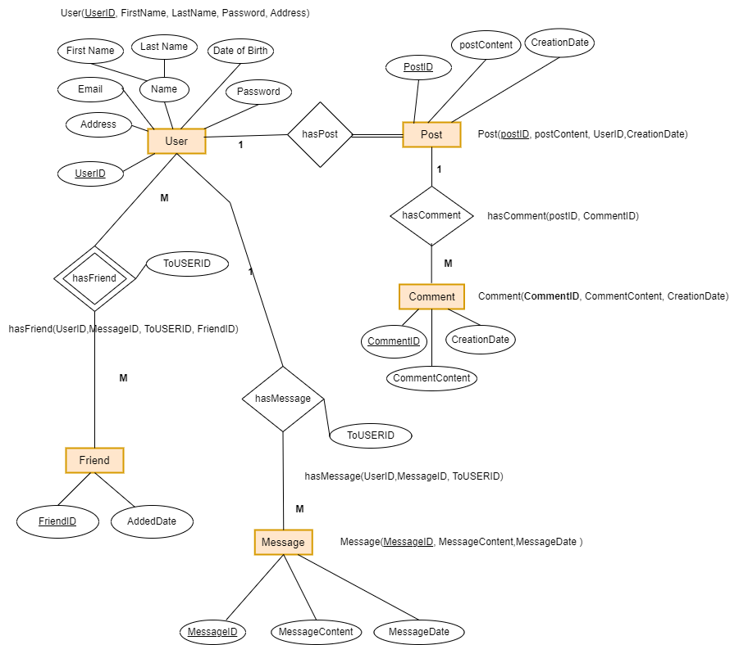
Entity Diagram

Slide 7
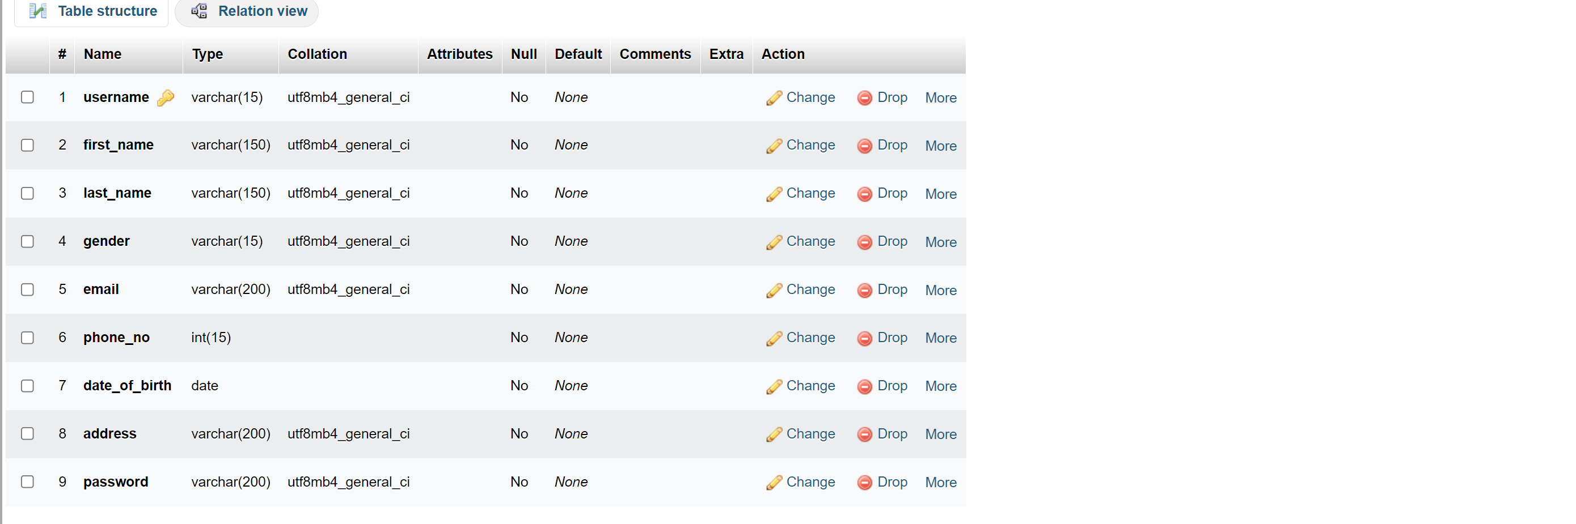
User_info

Slide 8
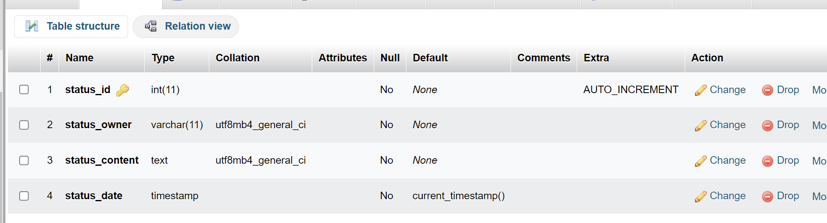
Status

Slide 9
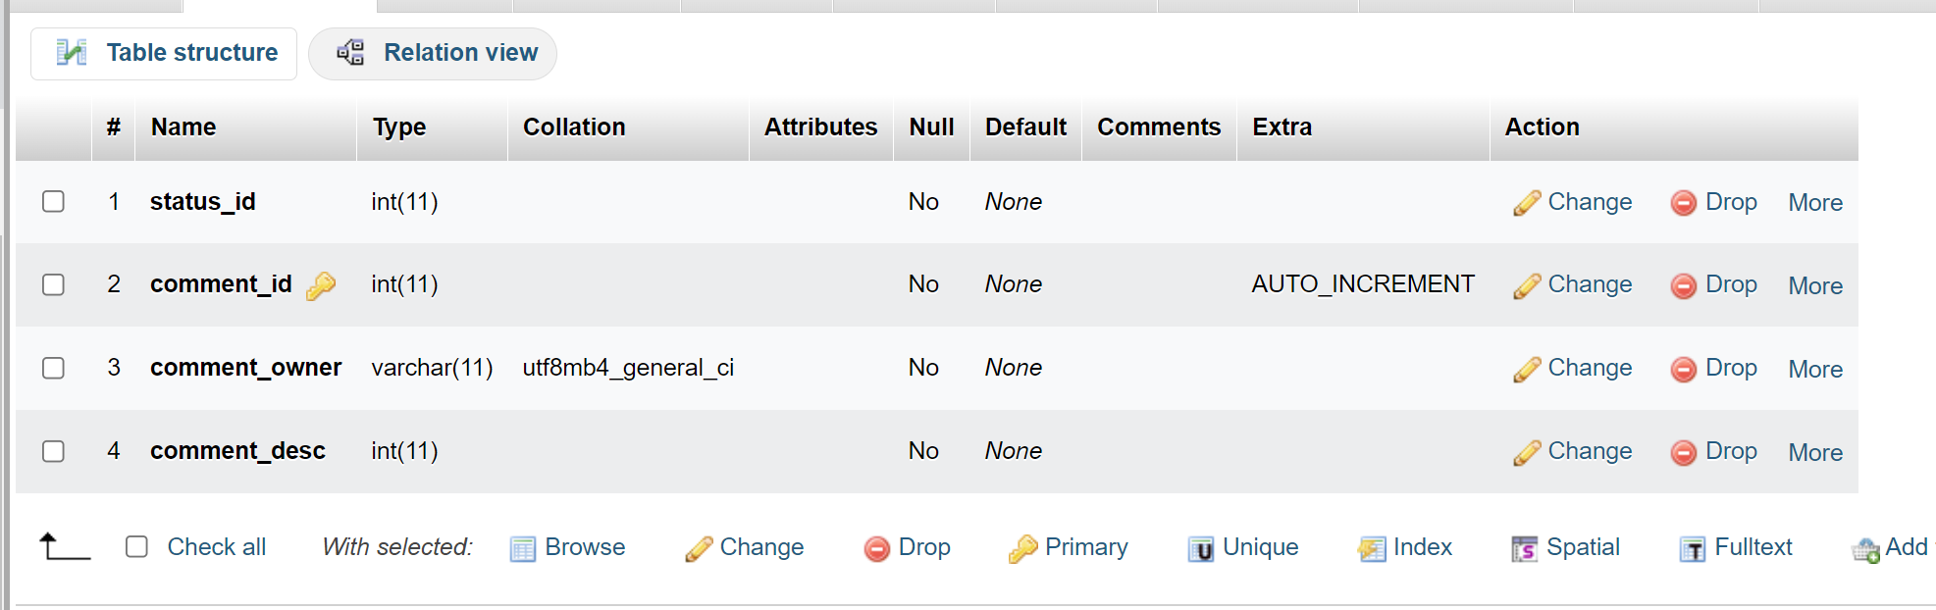
Status comments

Slide 10
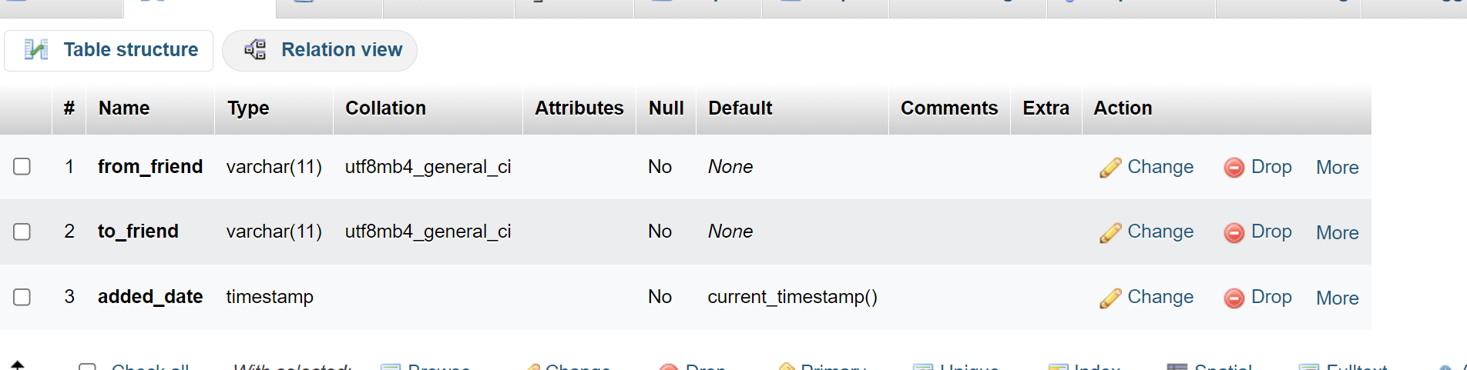
Friends

Slide 11
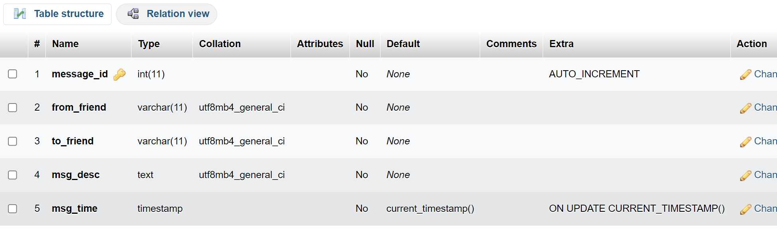
Message table

Slide 12
Thank You

